Slide 1









Slide 2

Decision-making is the process by which individuals select a course of action among several alternatives, to produce
a desired result ​

Slide 3
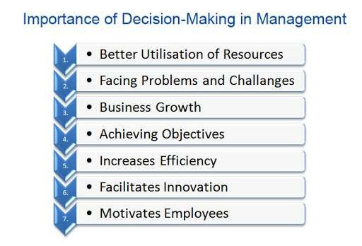

Slide 4



Types of managerial decisions
Programmed and non programmed
decisions
Major and minor decisions Routine and strategic decisions
Organizational and personal decision Individual and group decisions Policy and operating decisions

Slide 5
Programmed decisions
Programmed decisions are those which are normally repetitive in nature and are taken as a routine job and responsibilities
These types of decisions are made by middle level management in accordance with some policies, rules and procedures.
They have short term impact.
For example: – granting a leave to an employee, purchasing office materials etc.

Slide 6
Non programmed decisions
Non-programmed decisions relate to difficult situations for which there is no easy solution.
Non-programmed decisions are non repetitively taken by top executives.
They need to collect data and analyze then and forecast the strategic plans.
There is no standard procedure for handling such problems.

Slide 7
For example:, if an employee absents himself from his work for a long time without any intimation, the supervisor need not refer this matter to the chief executive. He can deal with such an employee according to the standard procedure, which may include charge sheet, suspension, etc. But if a large number of employees absent themselves from work without any information such a problem cannot be dealt in a routine manner. It has to be dealt with as an unstructured problem and the chief executive should take the decision. Non-programmed decisions require thorough study of the problem and scientific analysis of the situational factors. There has to be adequate probing and analysis of various alternatives before taking such decisions
Non programmed decisions

Slide 8
Major decisions
Decisions that are considerably more important than others
They are prioritized.
Taken by top management.
For example, replacement of man by machine, purchase of land and building diversification of product etc.
Minor decisions
Decisions that are considerably less important than others
They are not prioritized.
Minor decisions taken by lower level management people like office superintendent.
For example, store of raw materials, purchase of current assets with less value, etc.

Slide 9
Routine Decisions
Tactical or routine decisions are made repetitively following certain established rules, procedures, and policies.
These are everyday decisions that don't require much thought or analysis, as they involve familiar situations with predictable outcomes.
They may be complicated but are always one-dimensional.
They do not require any special effort by the manager. The managers at the middle and lower management level generally take such decisions.
Examples include deciding what to wear, what to eat for breakfast, etc.

Slide 10
Strategic Decisions
Strategic decisions are long-term and high-impact choices that shape the overall direction of an individual, organization, or project.
They often involve assessing risks, opportunities, and resources.
They are more important and so these decisions are taken by top management and middle management.
The higher the level of a manager, the more strategic decisions he is required to take.
The strategic decisions related to policy matters
Finding the correct problem in such decisions assumes great importance
Examples include market entry strategies, business expansion plans, and major investments.

Slide 11


Individual and group decisions
When a single employee is involved in decision making it is called individual decision.
Such decisions are generally taken in small organizations and in those organizations where autocratic style of management prevails.
When the decision is of group taken in a large organization where important and strategic decisions are taken the it is a group decision.
The main aim in taking group decisions is the involvement of maximum number of individuals in the process of decision- making.
E.g. Decision taken by the Board of Directors or a committee.

Slide 12
Organizational decision
Organizational decisions are those, that a manager takes in his official capacity.
Such decisions can be delegated
It is taken collectively keeping in mind the organizational goal.
Personal decisions
If the manager makes any decision in a personal capacity (affecting his/her life). It is known as personal decisions
These decisions are taken by him, not as a member of the organization.
It cannot be delegated.

Slide 13
Individual decisions
Individual decisions are made by a single person or by an individual in an official capacity
They can be routine or significant, depending on the context and impact.
Organizations that are smaller and have an autocratic style of management rely on such decisions.
Group decisions
Group decisions involve multiple individuals who collectively make a choice.
These decisions can be made through discussions, negotiations, and consensus-building processes.
Examples include team project decisions, committee decisions, decisions taken by the board of directors a group decision, etc.

Slide 14
Policy decisions
These are tactical decisions pertaining to the policy and planning of the firm are known as policy decisions.
Such decisions are usually reserved for the firm’s top management officials.
They have a long-term impact on the firm and require a great deal of analysis.
E.g. Company announces a bonus issue. This is a policy decision

Slide 15
Operating decisions
Operating decisions are the decisions necessary to put the policy decisions into action.
These decisions are taken by the lower management and help implement the plans and policies taken by the high-level managers.
Calculation and implementation of such bonus issue is an operating decision
Example: the bonus issue is a policy matter that is to be decided by the top management, and the calculation of the bonus is an operating decision, which is taken at the lower levels to execute the policy decision.

Slide 16
Sequential and Bear-by-the-Tail decisions
In a sequential decision, the manager makes a decision one part at a time;
when the results of the first part are known, he can use them in deciding the second part;
the results of the second part help in shaping his decision on the third part, and so on, with each succeeding part.

Slide 17
Decision-making process
Identification of problems
Results
Analyzing the problems
Action
Search for
alternatives
Choice of alternatives
Evaluation of alternatives

Slide 18
Identification and defining the problem
A Problem is the gap between present and desired state of affairs on the subject-matter of decision .
Clear definition of the problem is very important as the right answer can be found only to a right question.Pr
oblem identification
analysis

Slide 19
Analyzing the problem
After recognizing the problem, the next phase of decision-making is the analysis of problem, which involves classifying the problem and gathering information.
The problem should be classified keeping in view the following factors:
The nature of the decision, i.e., whether it is strategic or it is routine,
The impact of the decision on other functions
The futurity of the decision,
The periodicity of the decision, and
The limiting or strategic factor relevant to the decision.oblem identification
analysis

Slide 20

Search for alternatives
The next step in the decision-making process is the development of alternative courses of action
A decision maker can use several sources for identifying alternatives:
His own past experience,
Practices followed by others,
Using creative techniques
Can use brainstorming, research, or other methods to generate and list your alternatives.
Should include as many options as possible, without filtering or judging them at this stage.

Slide 21
Choice of alternative
Koontz and O’Donnell suggested three bases for a manager to select among the alternatives.
Experience: A manager is influenced to make decisions based on his past experience. However, he can give more reliance to past experience in case of routine decisions; but in case of strategic decisions, he should not rely fully on his past experience to reach a rational decision.
Experimentation: Under this approach, the manager tests the solution under actual or simulated conditions. This approach is used in test marketing of a new product. But it is very expensive and hence utilized as the last resort. It can be utilized on a small scale to test the effectiveness of the decision. For instance, a company may test a new product in a certain territory before expanding its sales nationwide.

Slide 22
Choice of alternative
Research and Analysis: It is the most effective technique for evaluating the alternatives when a major decision is involved. The impact of each alternative on the objective is evaluated. The one having the most positive impact is chosen. It weighs various alternatives by making models. It uses computer-based models and certain mathematical techniques. This makes the choice of the alternative more rational and objective.
Cost-benefit analysis: It is a systematic method for quantifying and then comparing the total costs to the total expected rewards of making a decision. If the benefits greatly outweigh the costs, the decision should go ahead; otherwise, it should probably not. A cost-benefit analysis will also include the opportunity costs of missed or skipped alternatives.

Slide 23
Action
Once the alternative is selected, it is put into action.
The main problem faced by the manager at the implementation stage is the resistance by the subordinates who are affected by the decision.
In order to overcome this resistance and make the decision acceptable, it is necessary for the manager to make the people understand what the decision involves, what is expected of them, and what they should expect from the management.
The principle of slow and steady progress should be followed to bring about a change in the behavior of the subordinates.
In order to make the subordinates committed to the decision, employees should be allowed to participate in the decision-making process

Slide 24
Action
The subordinates should not participate at the stage of defining the problem because the manager himself is not certain as to whom the decision will affect.
The subordinates should participate in the development of alternatives.
They should be encouraged to suggest alternatives. This brainstorming will result in certain alternatives, that may not be thought of by the manager.
Participative management is more successful than the other styles of management.
It will help in the effective implementation of the decision.

Slide 25

Results
When the decision is put into action, it brings certain results.
Results provide indication whether decision making and its implementation is proper.

Slide 26
Strategies
Strategy is a term that connotes a response to a competitive environment. In a competitive situation, it is not enough to build plans logically from goals unless the plans take into account the environmental opportunities and threats and the organizational strengths and weaknesses.
A corporate strategy is a plan that takes these factors into account and provides an optimal match between the firm and the environment.
Strategic Management is a process through which manager:
Formulates and implements strategies
Obtains strategic goal achievement

Slide 27
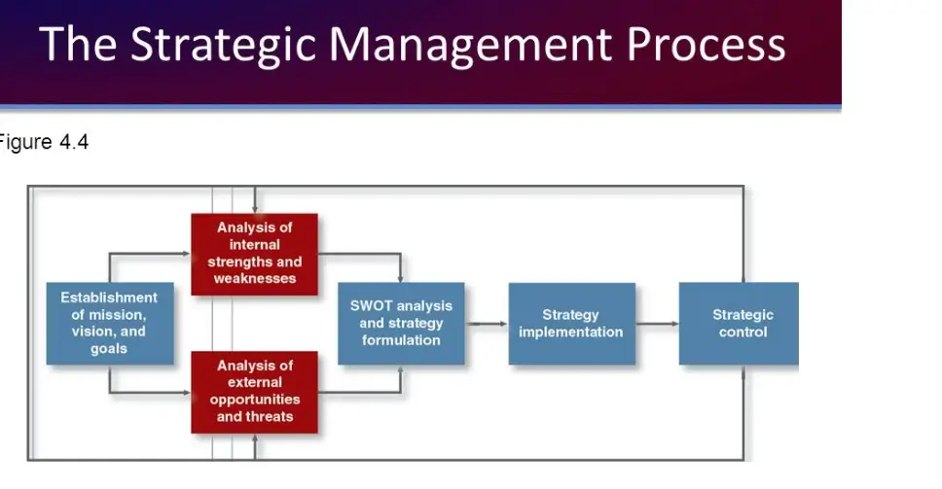

Slide 28
The Process of Strategy Formulation
Mission and objectives: The strategic management process begins with the firm’s mission and objectives.
The mission is the unique aim of an organization that sets it apart from others of its type.
What do we do?
Whom do we serve?
How do we serve them?
A firm’s mission guides the development of strategies. It establishes the context within which daily operating decisions are made and sets limits on available strategic options.
Objectives: It is the managerial commitment to achieve specified results.
Objectives are more specific than missions. E.g. To be profitable can be a mission statement. To attain 30% profit in the year 2022-2023 is the objective

Slide 29
Characteristics of Objectives
Objectives are multiple in number
Objectives change over time
Objectives are either tangible or intangible
Objectives have a priority
Objectives are generally arranged in a hierarchy
Objectives sometimes clash with each other

Slide 30
The Process of Strategy Formulation
2. External Analysis: The Management must conduct an analysis of the external environment. The External Environment needs to be analyzed to find the firm’s opportunities or to minimize the threats.
The external environment refers to government, competition, consumers, technological developments and other environmental factors that affect the organization. The purpose of such a review is to make sure that the factors important for competitive success in the market can be discovered so that the management can identify their own strengths and weaknesses as well as their competitors’
strengths and weaknesses.

Slide 31
The Process of Strategy Formulation
3. Internal Analysis:
Then the management needs to make an analysis of the Internal
environment. The Internal Environment refers to manpower, machinery, methods, procedures and other resources of the organization. A proper analysis of the Internal environment reveals the strengths and weaknesses of the organization. After taking note of the opportunities present in the environment, the firm has to identify the key areas where it wants to focus its energies based on its own strength and weakness.
4. Gap Analysis
The management must also conduct gap analysis, For this purpose, the management must compare and analyze its present performance level and the desired future performance level.
Such a comparison would reveal the extent of gap that exists between the present performance
and future expectations of the organization. If there is sufficient gap, the management must think
of suitable measure to bridge or close the gap.
5. Framing Alternative strategies:
After making SWOT analysis and the gap analysis, the management needs to frame alternative
strategies to accomplish the objectives of the firm. There is need to frame alternative strategies,
as some strategies may be put on hold, and other strategies may be implemented.
6. Choice of strategy:
The organization cannot implement all the alternative strategies. Therefore, the firm has to be
selective. The organization must select the best strategy, the organization needs to conduct costbenefit analysis of the alternative strategies. The strategies, which give the maximum benefits at
minimum cost, would be selected.

Slide 32
The Process of Strategy Formulation
4. Gap Analysis
The management must also conduct a gap analysis, For this purpose, the management must compare and analyze its present performance level and the desired future performance level.
Such a comparison would reveal the extent of the gap that exists between the present performance and future expectations of the organization. If there is a sufficient gap, the management must think of suitable measures to bridge or close the gap.
5. Framing Alternative strategies:
After making SWOT analysis and the gap analysis, the management needs to frame alternative strategies to accomplish the objectives of the firm. There is need to frame alternative strategies,
as some strategies may be put on hold, and other strategies may be implemented.

Slide 33
The Process of Strategy Formulation
6. Choice of strategy:
The organization cannot implement all the alternative strategies. Therefore, the firm has to be selective. The organization must select the best strategy, the organization needs to conduct a cost-benefit analysis of the alternative strategies. The strategies, that give the maximum benefits at minimum cost, would be selected.

Slide 34
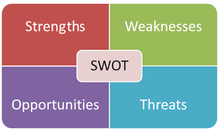

Slide 35
SWOT Analysis
SWOT analysis is a strategic planning and strategic management technique used to help a person or organization identify Strengths, Weaknesses, Opportunities, and Threats related to business competition or project planning.

Slide 36
Components of SWOT Analysis
Every SWOT analysis will include the following four categories.
Strengths
Strengths describe what an organization excels at and what makes it different from its competitors
Example: a strong brand, loyal customer base, a strong balance sheet, unique technology, and so on.
These are internal factors that exists within the organization and hence can be controlled.
Weaknesses
Weaknesses stop an organization from performing at its optimum level.
They are areas where the business needs to improve to remain competitive.
Example: a weak brand, higher-than-average turnover, high levels of debt, an inadequate supply chain, or lack of capital.

Slide 37
Components of SWOT Analysis
Opportunities
Opportunities refer to favorable external factors that could give an organization a competitive advantage.
For example, if a country cuts tariffs, a car manufacturer can export its cars into a new market, increasing sales and market share.
Threats
Threats refer to factors that have the potential to harm an organization.
For example, a drought is a threat to a wheat-producing company, as it may destroy or reduce the crop yield.
Other common threats include things like rising costs for materials, increasing competition, tight labor supply. and so on.

Slide 38
Components of SWOT Analysis
Internal Factors
What occurs within the company serves as a great source of information for the strengths and weaknesses categories of the SWOT analysis.
Examples of internal factors include financial and human resources, tangible and intangible (brand name) assets, and operational efficiencies.
Potential questions to list internal factors are:
(Strength) What are we doing well?
(Strength) What is our strongest asset?
(Weakness) What are our detractors?
(Weakness) What are our lowest-performing product lines?

Slide 39
Components of SWOT Analysis
External Factors
What happens outside of the company is equally as important to the success of a company as internal factors.
External influences, such as monetary policies, market changes, and access to suppliers, are categories to pull from to create a list of opportunities and weaknesses.
Potential questions to list external factors are:
(Opportunity) What trends are evident in the marketplace?
(Opportunity) What demographics are we not targeting?
(Threat) How many competitors exist, and what is their market share?
(Threat) Are there new regulations that potentially could harm our operations or products?

Slide 40
Components of SWOT Analysis
Armed with the ranked list of strengths, weaknesses, opportunities, and threats, it is time to convert the SWOT analysis into a strategic plan.

Slide 41
BCG Matrix
BCG matrix is a four celled matrix developed by BCG, USA.
It is the most renowned corporate portfolio analysis tool.
It provided a graphic representation for an organization to examine different businesses in its portfolio on the basis of their related market share and industry growth rates.
According to this technique, businesses or products are classified as low or high performers depending upon their market growth rate and relative market share.
Boston consulting Group Matrix (BCG matrix) can be used for resource allocation.

Slide 42
BCG Matrix
In a BCG matrix, products or business units are identified as question marks, stars, cash cows and dogs
The question Marks - are also called as wild cats are new products with potential for success, but they need a lot of cash for development. If such a product is to gain enough market share to become a leader and thus a star, Money must be taken from more mature products and spent on a question mark
The stars are market leaders and are usually able to generate enough cash to maintain their high market share. When their market growth rate slows, stars become cash cows.

Slide 43
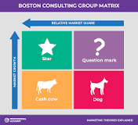
BCG Matrix
The cash cows bring in far more money than is needed to maintain their market share. In their declining ligfe cycle, the money of cash cows is invested in new question marks.
The dogs have low market share and do not have the potential to bring in much cash. According to BCG matrix, dogs should be either sold off or managed carefully for the small amount of cash they generate.

Slide 44
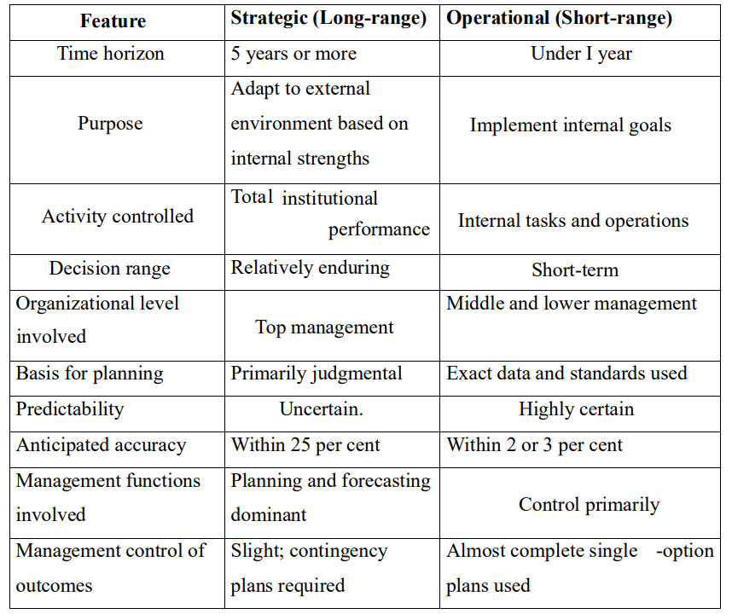
Strategic Plans Vs Operational Plan

